Slide 1
SHOP FOR HOME
JAVA FSD - C:9 - GROUP B - BATCH:5
Team Mentor:
Kiran Kumar Kurra
Members:
Dipali Bajirao Chaudhari

Slide 2
USER STORIES
As a user I should be able to login, Logout and Register into the application.
As a user I should be able to see the products in different categories.
As a user I should be able to sort the products.
As a user I should be able to add the products into the shopping cart.
As a user I should be able to increase or decrease the quantity added in the cart.
As a user I should be able to add “n” number of products in the cart.
As a user I should be able to get the Wishlist option where I can add those products which I want
but don’t want to order now
As a user I should get different discount coupons.

Slide 3
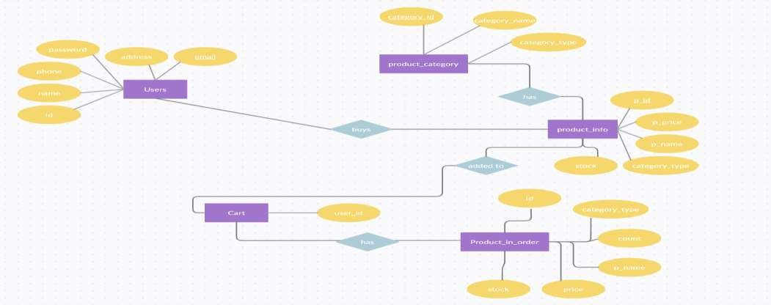
ENTITY RELATIONSHIP DIAGRAM
The Entity relation ship diagram displays the relationships between the entities that are stored in database.
The figure 1 represents the ER diagram of our Shop For Home application.
Figure 1 :ER Diagram of Shop For Home Application

Slide 4
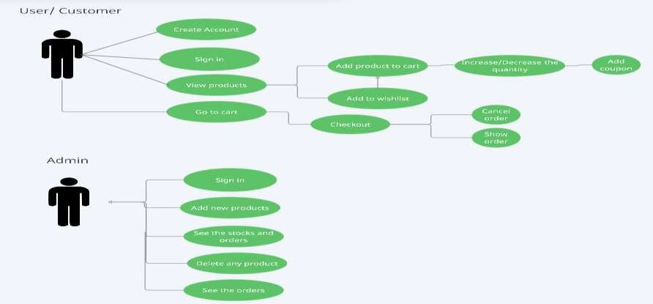
USE CASE DIAGRAM
A Use case diagram is a way to summarize the details of the system and the users within that system.
The figure 2 represents the use case diagram of our Shop For Home application.
Figure 2 :Use Case diagram of Shop For Now

Slide 5
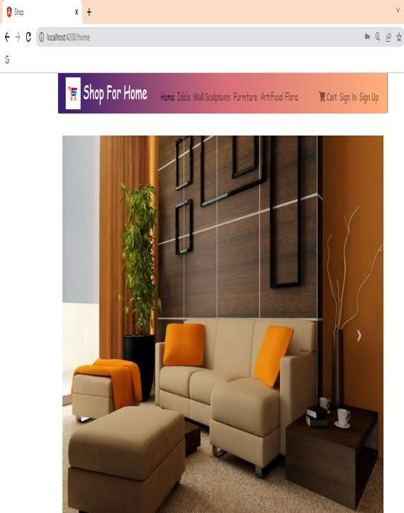
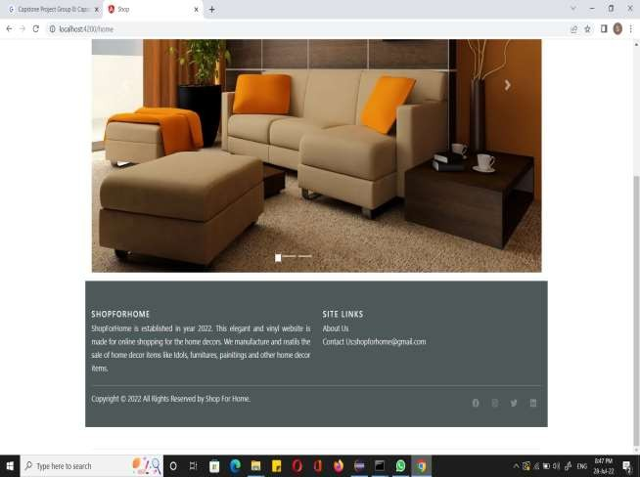
SCREENSHOTS

Slide 6
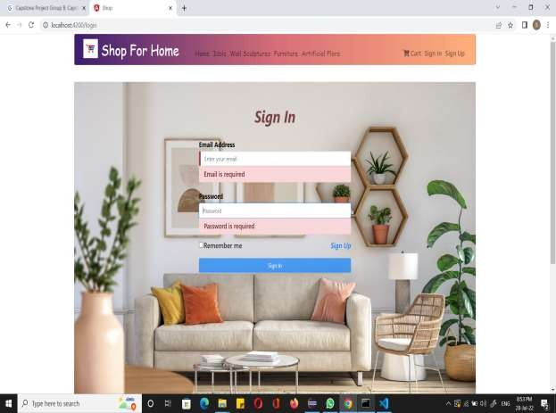
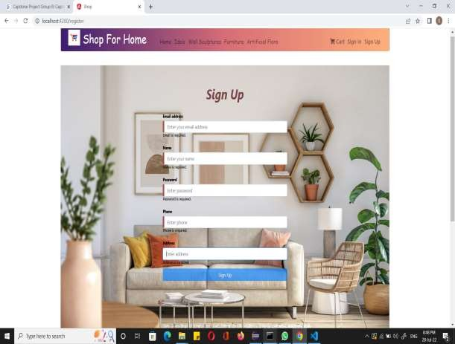
SCREENSHOTS

Slide 7
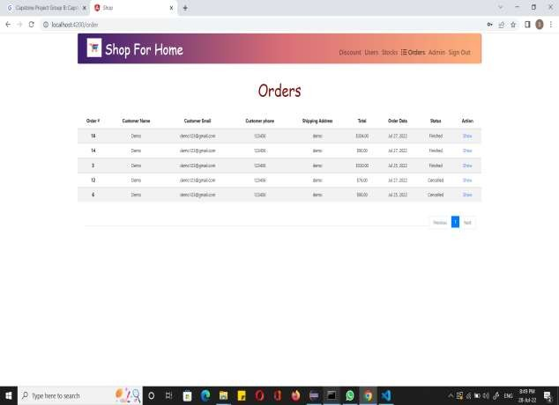

SCREENSHOTS

Slide 8
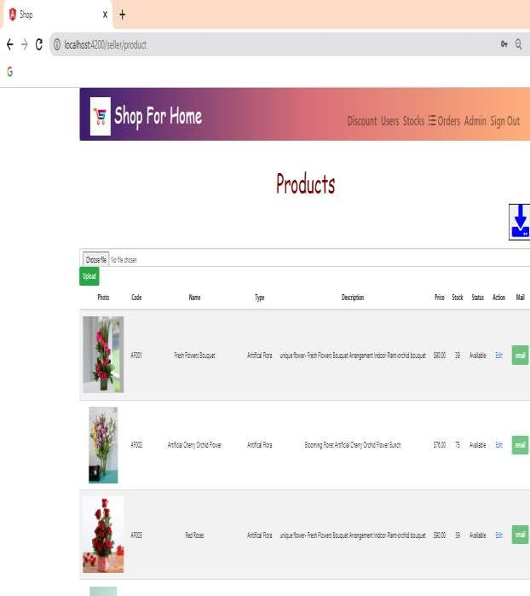
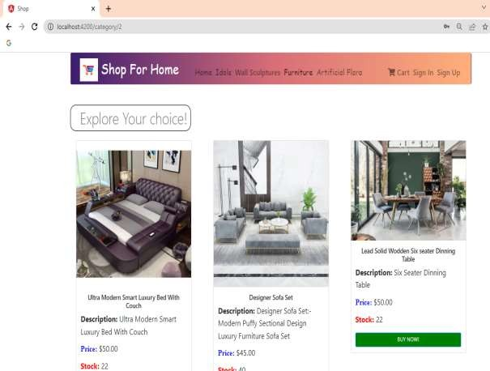
SCREENSHOTS

Slide 9

Thank You

